Slide 1




















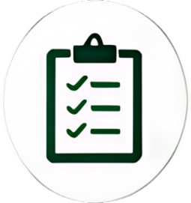


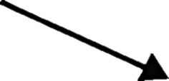



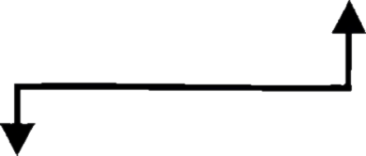

















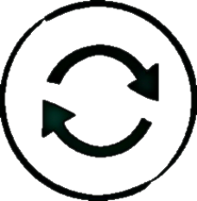


How the Operating Model Works in Practice
This process view shows how the single 2LoD front door works in practice - from triage and early engagement
through live operation, incident handling and change re-assessment.
Desired Al Risk Oversight workflow
Broader triage and assessment process
PwC triaging tool focus
Initial triage only
Block /No Go/Direction of change
Enhanced
Incident
identification
Root cause analysis
and solution
identification
High-risk
indicators trigger
initial review.
Al Oversight Forum
Resolve
issue
Standard
Use case
materiality
assessment
Typical risk use
cases proceed
through the
standard
Async
engagement
Responsible
Al Journey
Change is
identified and
logged
governance route
and identify which
2LoD teams need
to be engaged.
Change
triaging
Model owner
completes triage
after the
consequence
scanning
workshop in the
RAI journey.
Triaging
Live
Model
IT/ICP
Data
Approvals for Tier 3
and below granted
by MRO
Log non-material
changes and
notify 2LoD
Light
ECP
Market
Conduct
Payments
Very low risk
use cases may
proceed at MÓ
approval/
attestation.
Supplier
Conduct
Change
Minor or material changes will be
reviewed by relevant 2LoD teams
to determine the level of re-engagement.
DAIEC
Customer &
Product
Business
Continuity
Key message:
PwC focuses on front-door triage; Al Risk Oversight needs the
end-to-end review, engagement, assessment, evidence, and reassessment workflow.
The operating model turns the single 2LoD front door into a practical governance journey:
risk-based triage, proportionate engagement, structured escalation, and clear re-assessment of changes.

